Slide 1
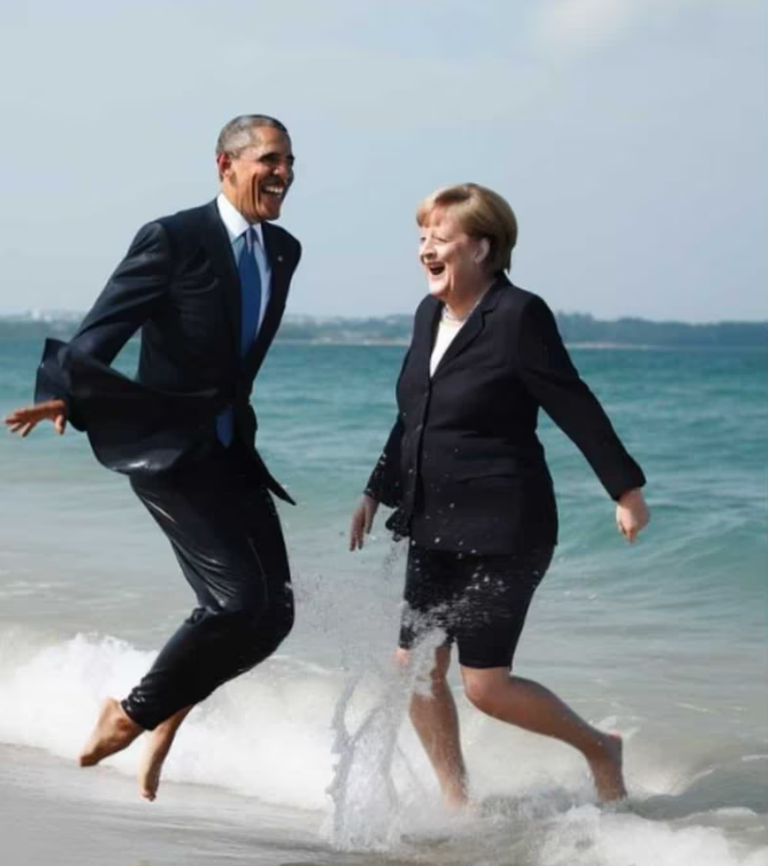
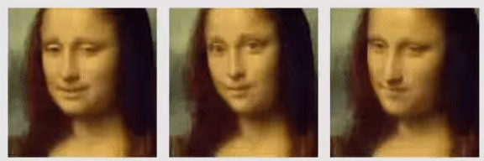
Artificial Facial Detection: Separating Real Faces from the Artificially Generated
Egor Zakharov Skolkovo Institute of Science
Udhbhav Gupta & Ante Tonkovic-Capin
@julian_ai_art/Instagram
Notes:
Good morning!
This is Udhbhav and I’m Ante and our project is Artificial Facial Detection, Separating Real Faces from the Artificially Generated
Here’s an example of how powerful the techniques in this field have become, bringing Mona Lisa alive from multiple perspectives using a single reference image
And clearly President Obama and former German chancellor Angela Merkel never frolicked around on the beach, at least not that I’m aware of

Slide 2
Introduction - AI Fueled Arms Race
Technology for creating artificially generated images has become increasingly sophisticated.
Breakthroughs in artificial generation lead to new efforts to identify and detect forgeries, leading to an arms race in the field between generation and detection techniques
The potential for malicious use and spreading misinformation is immense
Our project aims to explore the potential of implementing an AI-generated detection system for facial images using a two-phase pipeline
Notes:
AT
We wanted to do our project on this topic because of how important and prescient this issue has become
As we saw from the previous slide, the technology and techniques for generating artificial facial images has become quite sophisticated, and it’s only improving
These improvements then propel new efforts to detect and identify them, leading to a sort of arms race between their generation and their detection.
The reason for this is clear, the potential for malicious use and spreading misinformation is immense.
Because of this potential, and the increasing sophistication of these techniques, our project explores the potential of implementing a two-phase pipeline for detecting and classifying artificially generated human faces
OPTIONAL:
Some of you may have heard of the term “deep fakes”, which, among other things, has been used to describe particularly realistic or convincing forgeries or manipulations of human faces

Slide 3

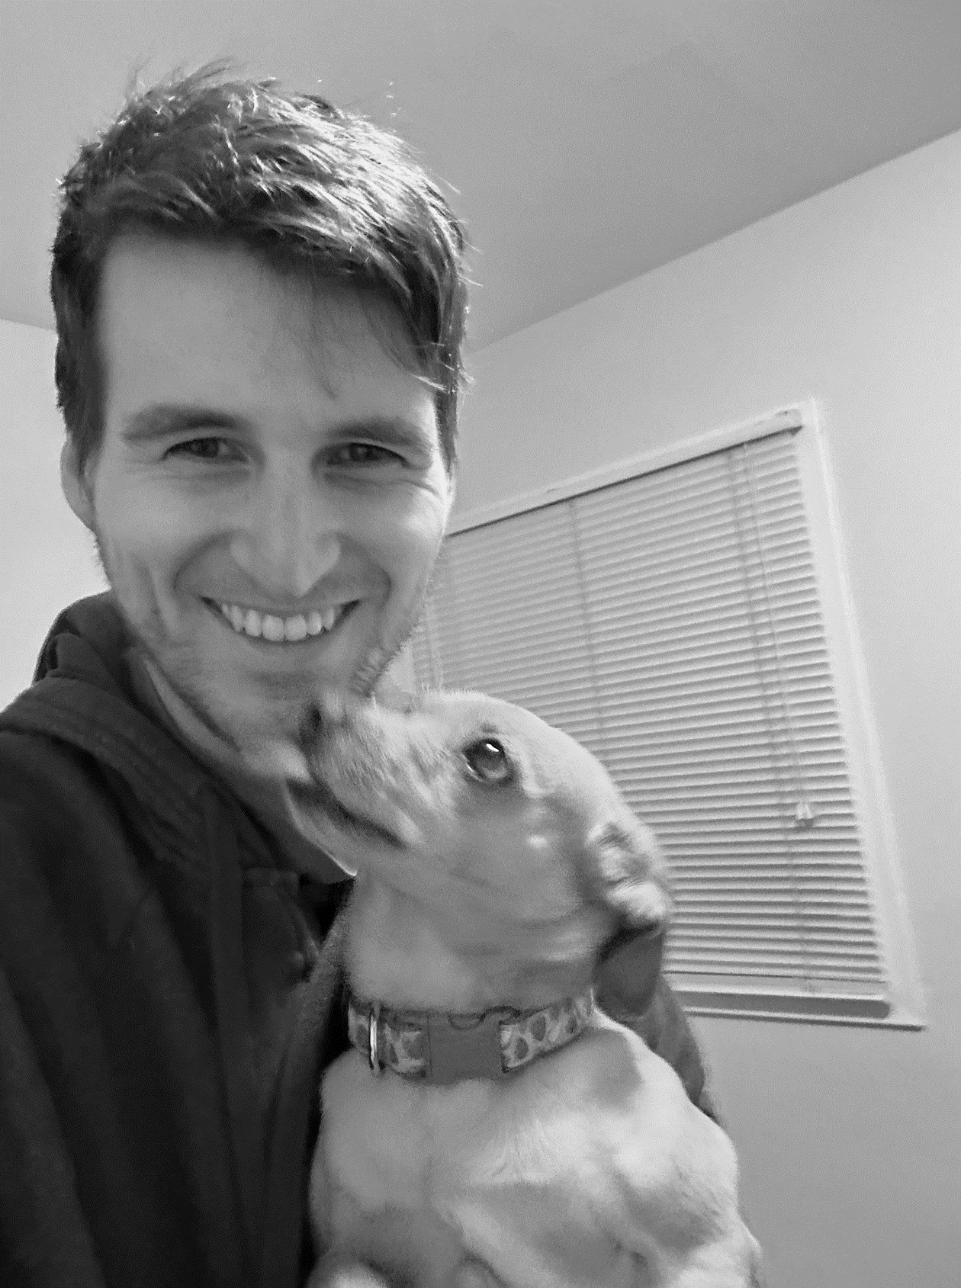


Defining Classification: What does it mean to be a “Real Face”
The face, as digitally represented, is considered real if it existed physically as a biological human at a moment in time and faithfully depicts the countenance, demeanor and position originally expressed by the digital representation such that the average observer’s prima facie impression closely reflects the reality of the moment captured digitally.
Right image generated using Stable Diffusion model at https://www.artguru.ai/ai-text-to-image-generator using left-most image as input
Notes:
AT:
First, we need to define what it means to be a “real” face, this is a harder question than it might initially seem.
With the widespread use of image processing, filters on social media, image manipulation has become a widespread phenomenon.
These tools have democratized the ability to alter images, making it possible for anyone to modify their photos with just a few taps on a screen.
From simple filters that adjust lighting and color, to more complex features that can smooth skin, change eye color, or even reshape facial features, these apps have transformed the way we present ourselves online.
While these tools can be used creatively and for fun, they also raise questions about authenticity and blur the line between what should be considered “real” and “fake”.
Take these four images as an example, as we go from left to right we increasingly manipulate the image using various techniques.
Imagine if these were on a wider spectrum, at which exact point do we stop and say this face is no longer a "real" one?

Slide 4
Related Work
Image Artifact Based Approaches
watermarks, sensor noise patterns, file format compression signals, lens aberrations etc.
Deep CNN models
Color statistics feature set
DeepFD: Joint discriminative feature learning with contrastive loss
Notes:
UD
In terms of related work in this field
there has been research done on detection models based on image artifacts like …….
But these work well on traditional methods of image forgery like photoshop and not so much on AI generated images
Deep CNN models work well on the GAN generated dataset that they are trained on but don't generalize well to detecting images from other GANs
To detect all AI generated images, not specifically faces, a research team developed a feature set from image color statistics and detection models based on this feature set have generalized well
Lastly a joint feature learning and classification model, DeepFD, has also performed well by using contrastive loss to model the common underlying features of fake images that differ from real images

Slide 5
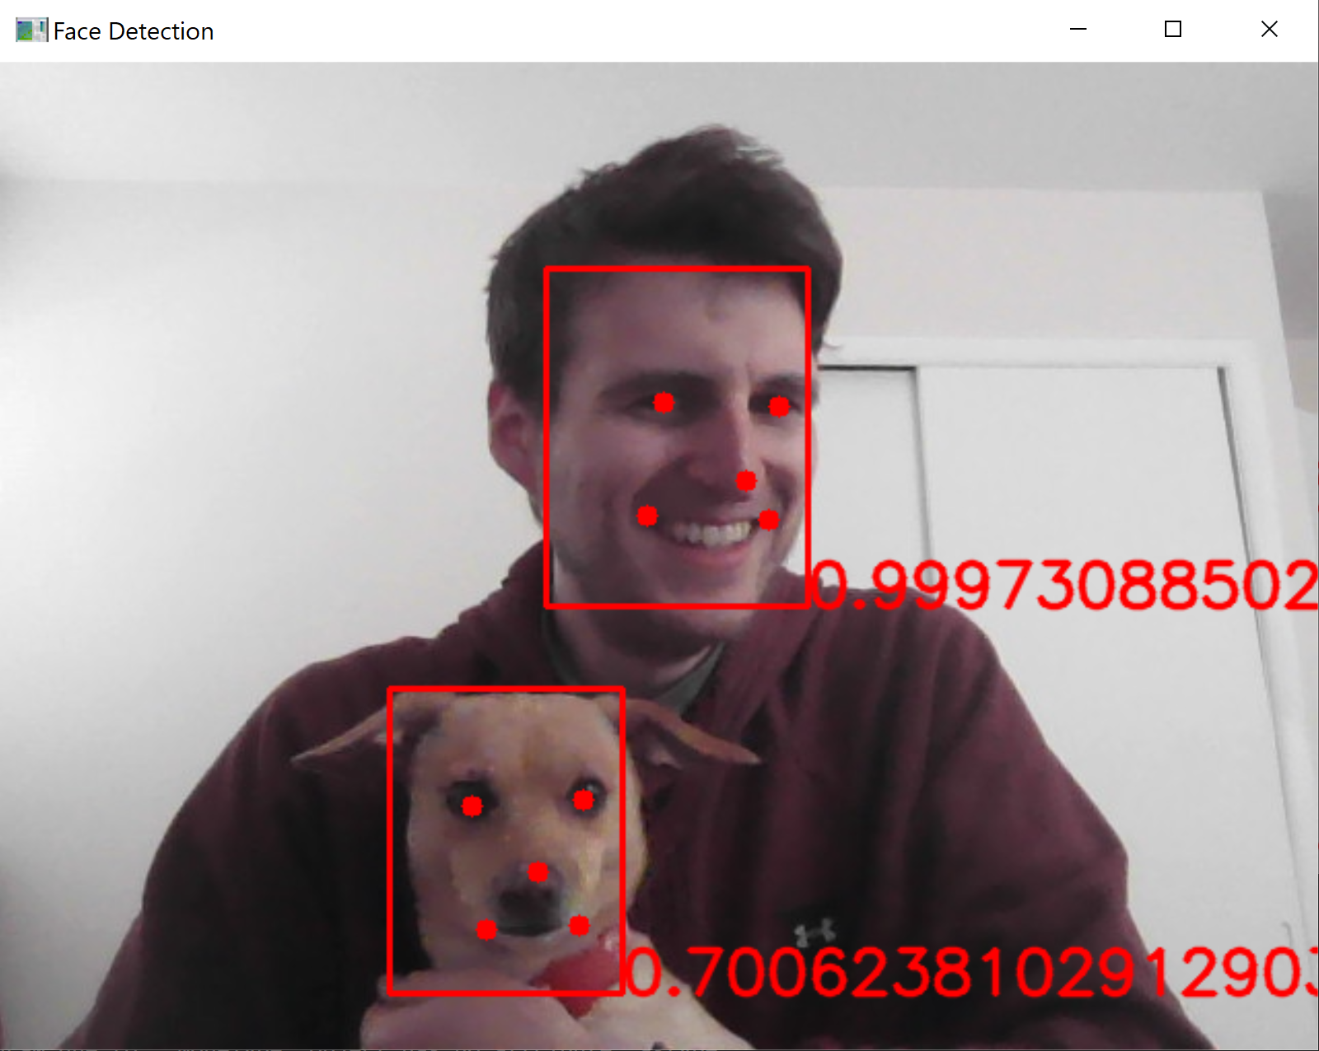
Facial Detection using MTCNN
Facial detection using Multitask Cascaded Convolutional Networks (MTCNN)
Extract using resultant bounding box and center on features
Resize and normalize as new image for input to CNN
Multitask comes from the cascading architecture with three tasks: Propose, Refine and Output
Zhang, K., Zhang, Z., Li, Z., and Qiao, Y. (2016). Joint face detection and alignment using multitask cascaded convolutional networks. IEEE Signal Processing Letters, 23(10):1499–1503.
Notes:
AT
At a high level, our project takes a two-phased approach. The first phase leverages Multitask Cascaded Convolutional Networks or MTCNN
MTCNN is a powerful algorithm for facial detection, iteratively feeding candidate detections through 3 different networks:
One for isolating potential facial bounding boxes, one for refining those detections, and another for outputting them and associated landmarks.
Here's an example of how MTCNN works.

Slide 6


Facial Detection and Extraction Example
Highest probability beyond specified threshold chosen as facial feature, extracted, resized, post-processed and normalized prior to input to CNN
Notes:
AT:
Once the face is detected and isolated using the MTCNN phase, we extract it from the image and apply any required resizing and normalization.
Here you can see that, while MTCNN is capable of detecting Kiki’s face, we only grab the first most likely facial candidate to use in our pipeline.

Slide 7
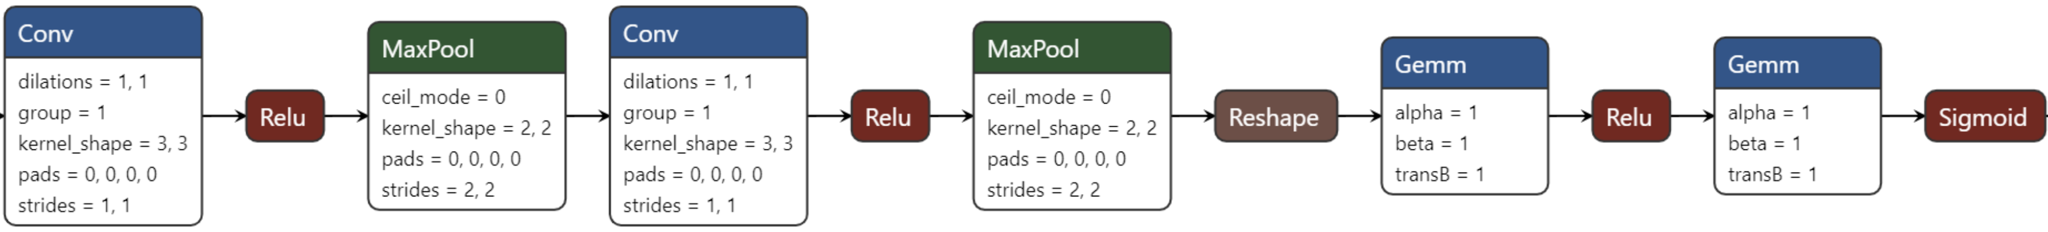
CNN Binary Classifier
Used dataset comprising 70,000 real faces from Flickr and 70,000 fake faces generated from the StyleGAN model, originally collected and provided by Nvidia
Facial image extracted from phase 1 passed through CNN comprised of two convolutional layers and two fully connected ones yielding output for binary classification
https://www.kaggle.com/datasets/xhlulu/140k-real-and-fake-faces
Notes:
AT
From there, we move to the second phase of our process, a CNN trained against the images from the MTCNN phase.
We used a dataset containing 140k total images
Here's the ONNX graph of the format

Slide 8
Best Results & Model Pipeline to Date:
Image
┌───────────┬─────────────────────┐
│ P1 Model │ MTCNN (0.5M params) │
│ P2 Model │ CNN (11.9M params) │
│ Results │ 8852 of 9998 │
│ Accuracy │ 88.54% │
│ Loss │ 0.4020 │
│ TP │ 4604 │
│ FP │ 751 │
│ FN │ 395 │
│ TN │ 4248 │
│ Precision │ 0.86 │
│ Recall │ 0.92 │
│ F1-Score │ 0.89 │
└───────────┴─────────────────────┘
MTCNN for face detection, bounding box regression and facial landmark localization tasks
Proposal-Net
Refine-Net
Output-Net
CNN for facial binary classification
Real or Fake
79x79x48
Conv: 3x3
MaxP: 2x2
38x38x128
Conv: 3x3
MaxP: 2x2
64x184832
64x1
σ(x)
FC1
FC2
MTCNN Paper: Long-Hua Ma, Hang-Yu Fan, Zhe-Ming Lu, Dong Tian (2020), Acceleration of multi-task cascaded convolutional networks. IET Image Process., 14: 2435-2441. https://doi.org/10.1049/iet-ipr.2019.0141
Notes:
AT:
Here’s how the full process looks from start to finish.
Using this 2-phase approach to first detect, isolate and extract candidate faces, then using those features to train our own CNN classifier, here are the best results we’ve had to date.
OPTIONAL:
Series of 3 small CNNs
P-Net: generates candidate bounding boxes
R-Net: refines and eliminates false positive bounding boxes, predicts facial landmarks like eyes, nose, mouth
O-Net: final calibration on bounding boxes, refines landmark predictions
Followed by the classification CNN
2 convolutional layers and a feed forward network with 2 hidden layers
Outputs a probability of an image being real

Slide 9
Exploratory Results & Various Approaches
Initially explored a couple different datasets and models, including pretrained CNNs for classification
┌────────────┬────────────┬────────┬────────────┬───────────┬──────────┐
│ Model │ Parameters │ Epochs │ Learn Rate │ Dataset │ Accuracy │
├────────────┼────────────┼────────┼────────────┼───────────┼──────────┤
│ vit-l-32 │ 306.5M │ 20 │ 5e-3 │ StyleGAN │ 50.18% │
│ vit-b-16 │ 86.6M │ 20 │ 1e-2 │ Photoshop │ 52.58% │
│ ffd-1k │ 1.6M │ 20 │ 3e-4 │ Photoshop │ 54.23% │
│ ffd-5k │ 1.6M │ 20 │ 3e-4 │ StyleGAN │ 77.90% │
│ ffd-5k │ 1.6M │ 80 │ 1e-4 │ StyleGAN │ 78.70% │
│ ffd-5k │ 1.6M │ 80 │ 2e-4 │ StyleGAN │ 79.30% │
│ ffd-5k │ 1.6M │ 50 │ 3e-4 │ StyleGAN │ 80.20% │
│ ffd-10k │ 11.8M │ 50 │ 2e-4 │ StyleGAN │ 83.30% │
│ ffd-50k │ 11.8M │ 10 │ 1e-4 │ StyleGAN │ 92.14% │
│ ffd+fe-10k │ 11.8M │ 50 │ 2e-4 │ StyleGAN │ 78.16% │
│ ffd+fe-50k │ 11.8M │ 10 │ 1e-4 │ StyleGAN │ 88.50% │
└────────────┴────────────┴────────┴────────────┴───────────┴──────────┘
Photoshop Dataset: https://www.kaggle.com/datasets/ciplab/real-and-fake-face-detection Computational Intelligence and Photography Lab, Yonsei University
Notes:
Initially started our project by exploring which model type would work best for classifying images as fake or real. Candidates: Vision Transformer, CNN
Vision Transformer is a relatively new architecture that divides images into patches, converts patches into vector embeddings, and then uses a transformer encoder to learn dependencies and relationships between different patches
Vision transformers do well on typical image classification tasks but didn't work well for us in detecting fake images
Likely due to less emphasis on local features than global relationships, and perhaps needs larger dataset
All other rows correspond to the CNN model that we've discussed
We trained both model types with different configurations and hyperparameters and on different datasets
Eventually chose the CNN due its better accuracy
Next, we compared the performance of the CNN with and without input images being pre-processed with the MTCNN face extraction

Slide 10

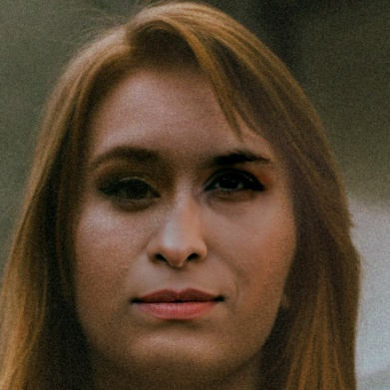
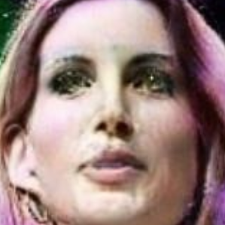
Facial Extraction (FE) Impact
Dataset | Test Accuracy (%)
 | Without FE | With FE
StyleGAN + Real | 92.14 | 88.50
StarGAN + Real | 44.77 | 50.11
Photoshop + Real | 81.07 | 90.68
StyleGAN Generated Face
Without FE: Real (0.9997)
With FE: Fake (0.2559)
Photoshop Manipulated Face
Without FE: Real (0.9846)
With FE: Fake (0.0265)
StarGAN Generated Face
Without FE: Real (0.9998)
With FE: Fake (0.4310)
Notes:
Goal of our project is to show that fake facial image detection works better with facial extraction
However you'll notice that the CNN Test accuracy is higher without FE on stylegan dataset which is what the model was trained on. We believe this is because
Without FE the model has more background pixels to learn from (256x256 vs approx. 160x160 after FE), so the model captures more information about synthetically generated pixels but those background pixels don't provide any info about synthetic facial features which we ideally want our model to learn
By using FE, we not only restrict the model to only learn on pixels representing facial features, but we also make the model capture information about different facial orientations better (talk about image)
After training the model only on the StyleGAN dataset with and without FE, we also wanted to test how the model generalizes to other datasets of fake images
Unsurprisingly test accuracy was low on StarGAN which falls is in line with the fact that regular CNNs only tend to work well for the GAN whose images they are trained on and don't generalize well to other GANs
However the model did surprisingly well for photoshopped faces dataset which we didn't expect
The most important observation we made was that the CNN model with FE, despite being trained only on StyleGAN images, had much better accuracy on unknown datasets than the model without FE

Slide 11
Conclusion
MTCNN is one of the most accurate facial detection models. For inference tasks, it is fast, accurate and also identifies facial landmarks
Pre-processing image data with MTCNN for facial extraction provides more reliable results from the CNN classifier and tends to generalizes better
Classifying images as real or AI generated remains a challenge and active area of research, particularly from a generalization perspective
Next Steps
Model parameter tuning
Model training and performance analysis on heterogenous dataset
Notes:
UD:
To summarize

Slide 12
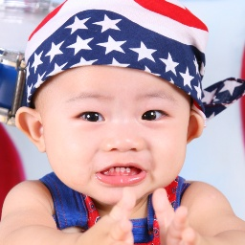
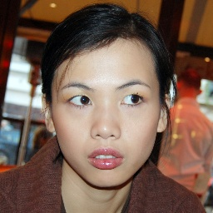

Real or Fake?
Q/A
Notes:
Q/A anyone have a guess?

